Slide 1

Course: AWS devops Trainer: Mr.Madhukar
PROJECT -1
Name: D.Saritha
Mail id: dosalasaritha123@gmail.com

Slide 2
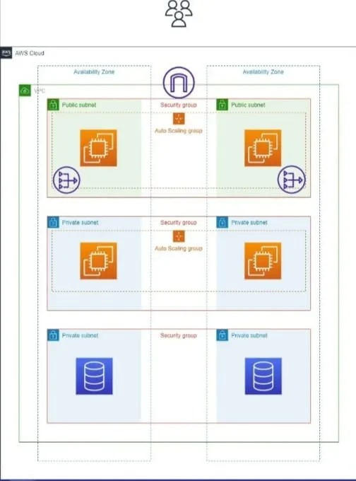

Slide 3
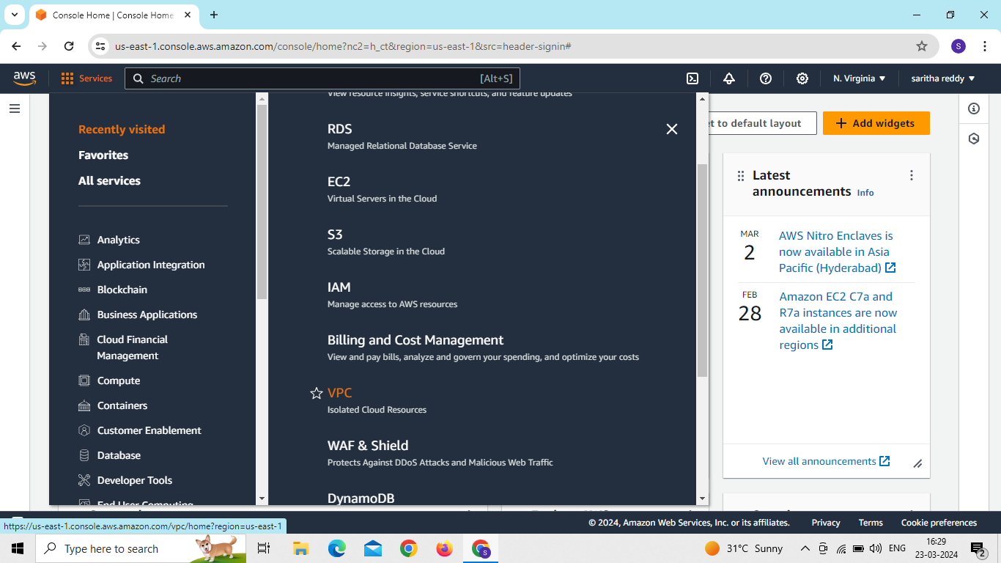
Create vpc and connect subnets through autoscaling and connect RDS

Slide 4
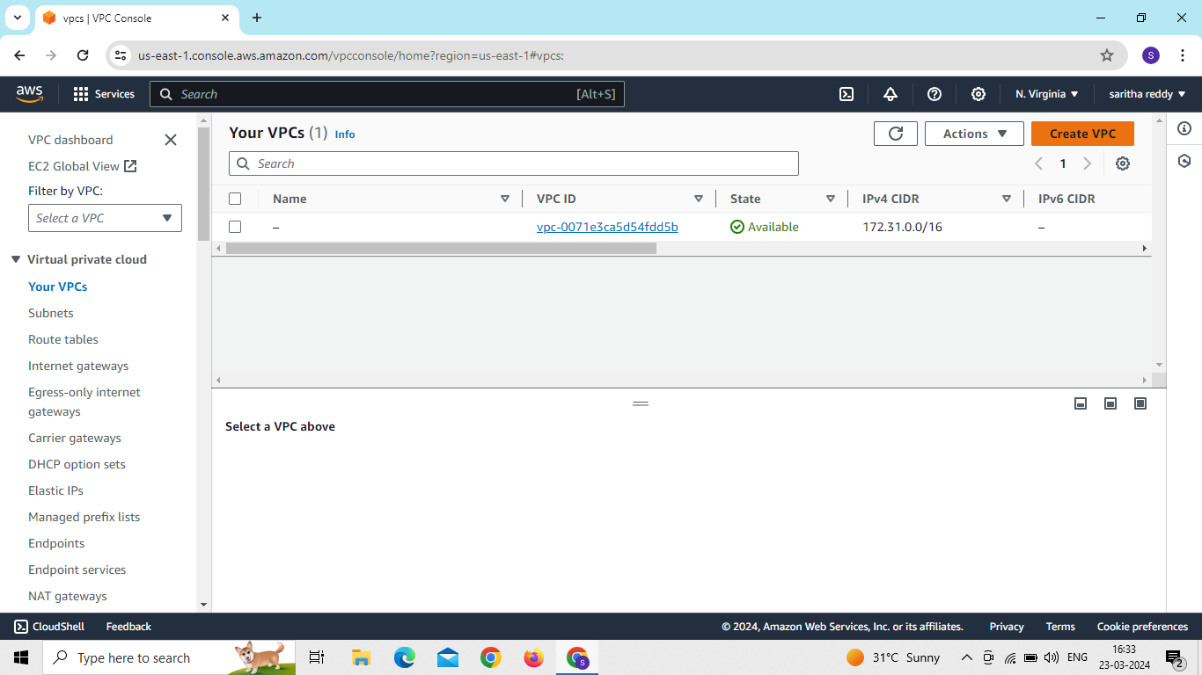
Click on create vpc
Enter vpc name and CIDR value and click on create vpc

Slide 5
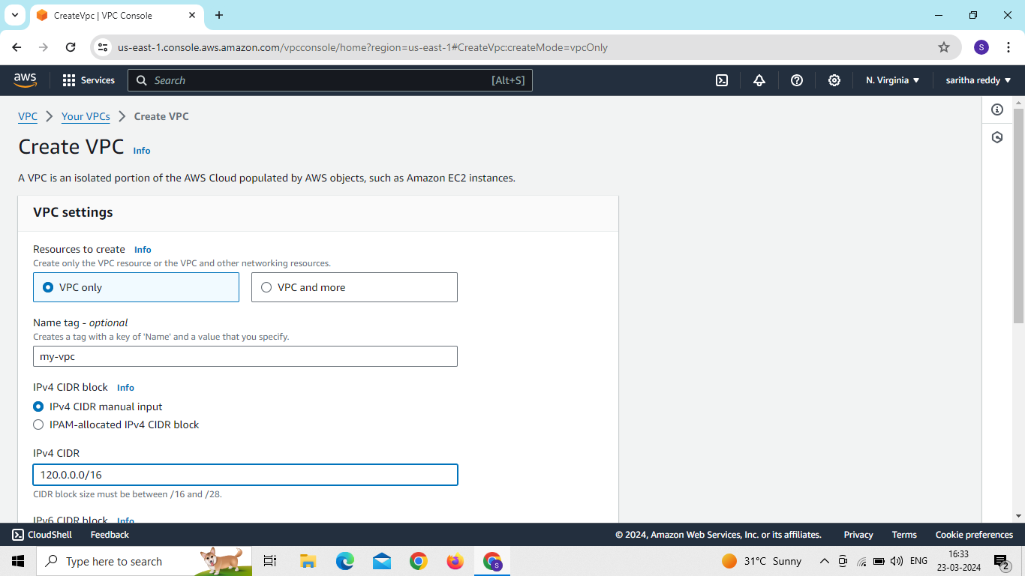
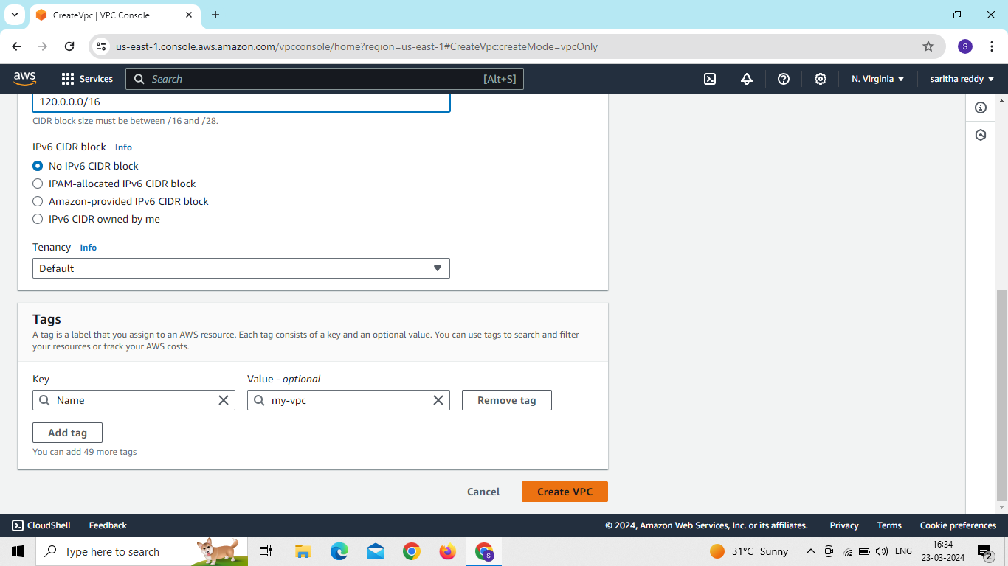

Slide 6
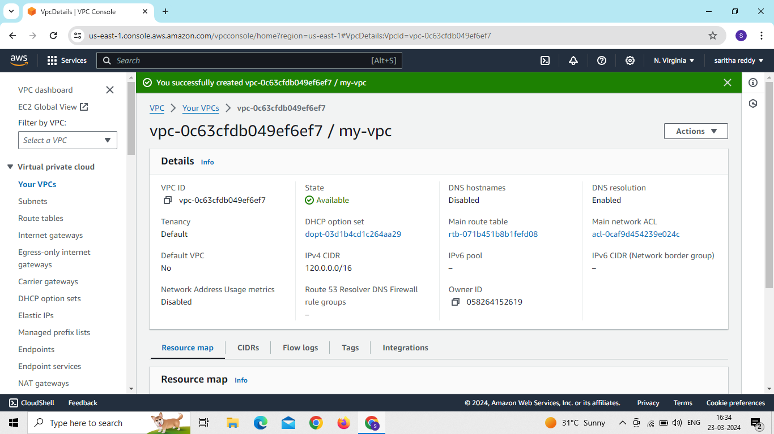

Slide 7
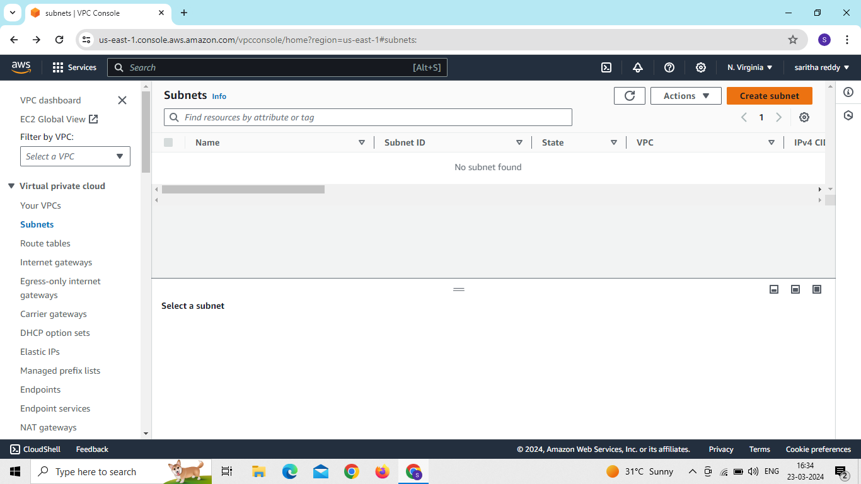
Click on create subnet
Select our vpc and create two public subnets
Click on add subnet

Slide 8
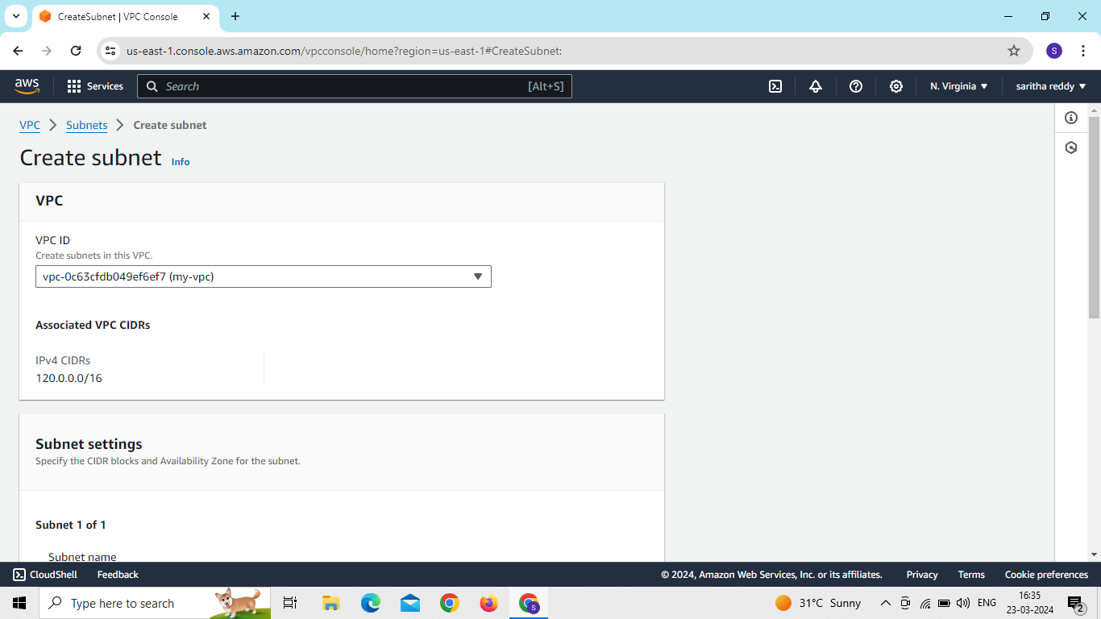
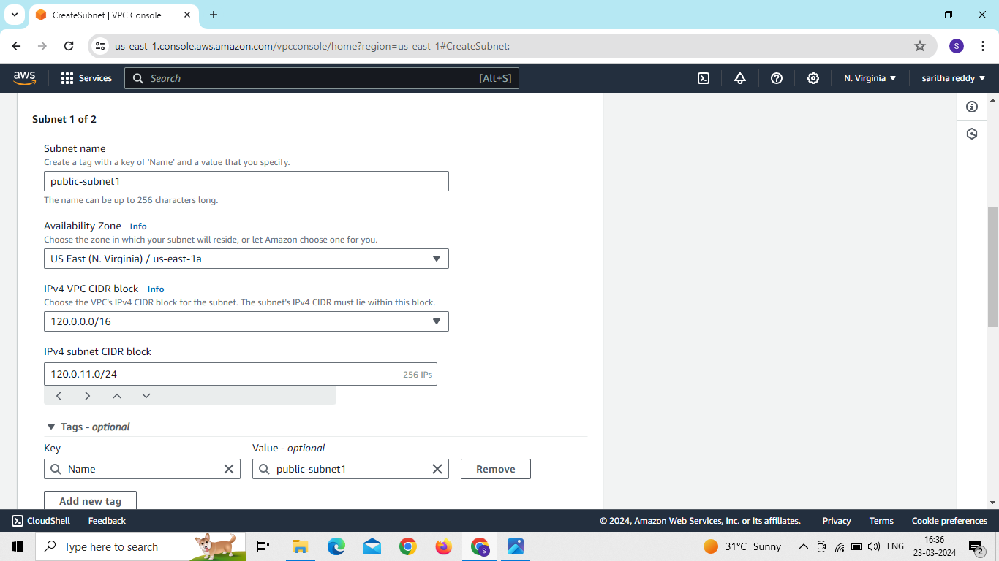

Slide 9
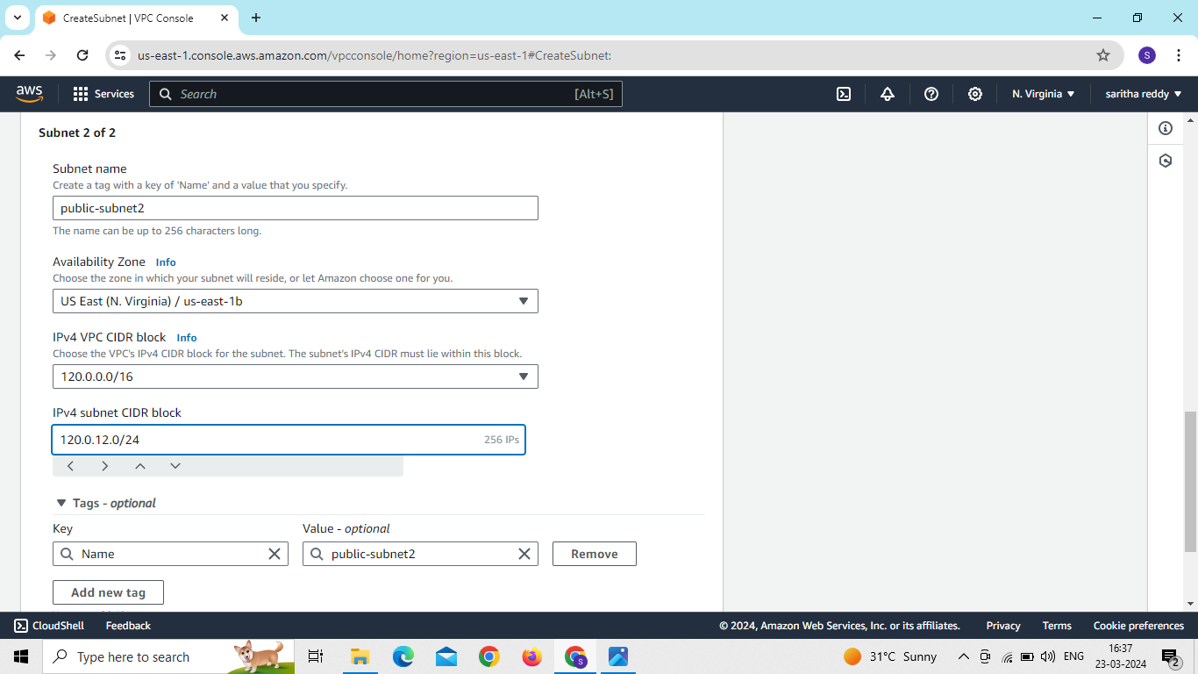
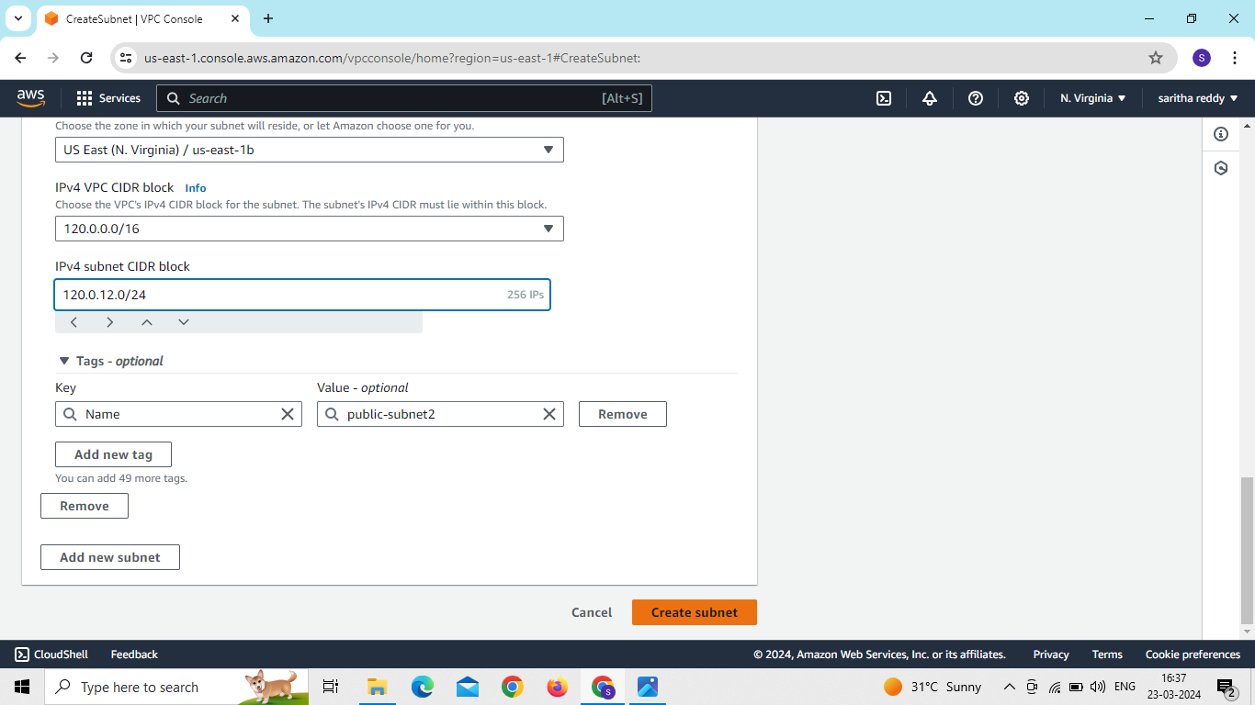

Slide 10
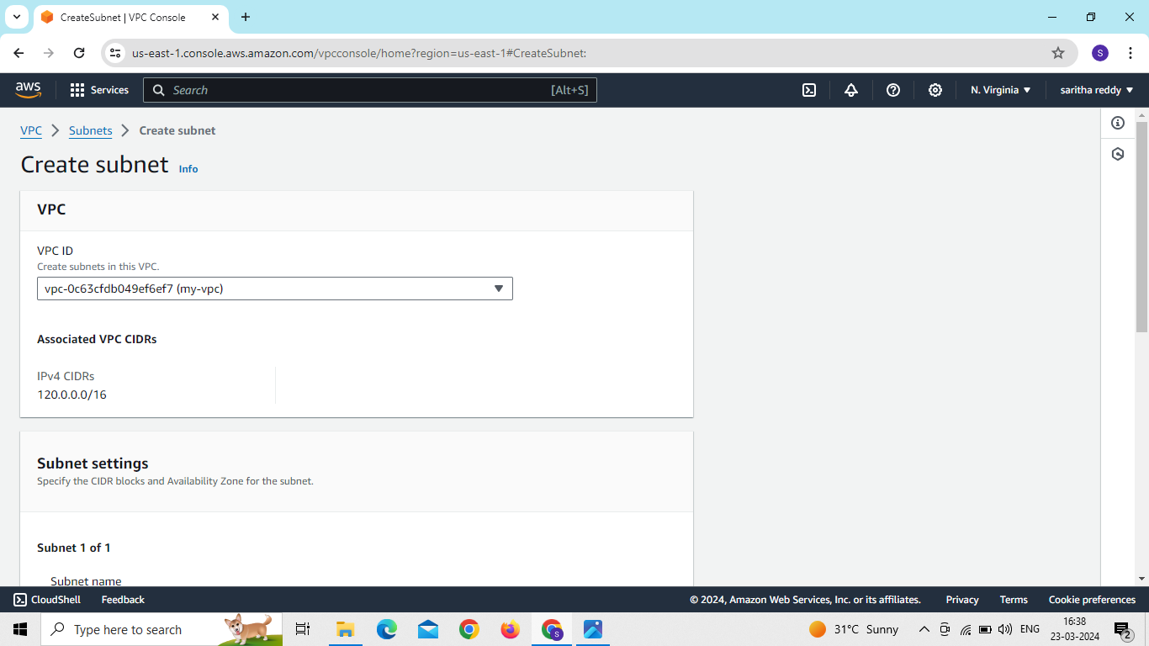
Go to subnets and create 2 private subnets and give CIDR value
Select our vpc and select region
Add new subnet

Slide 11
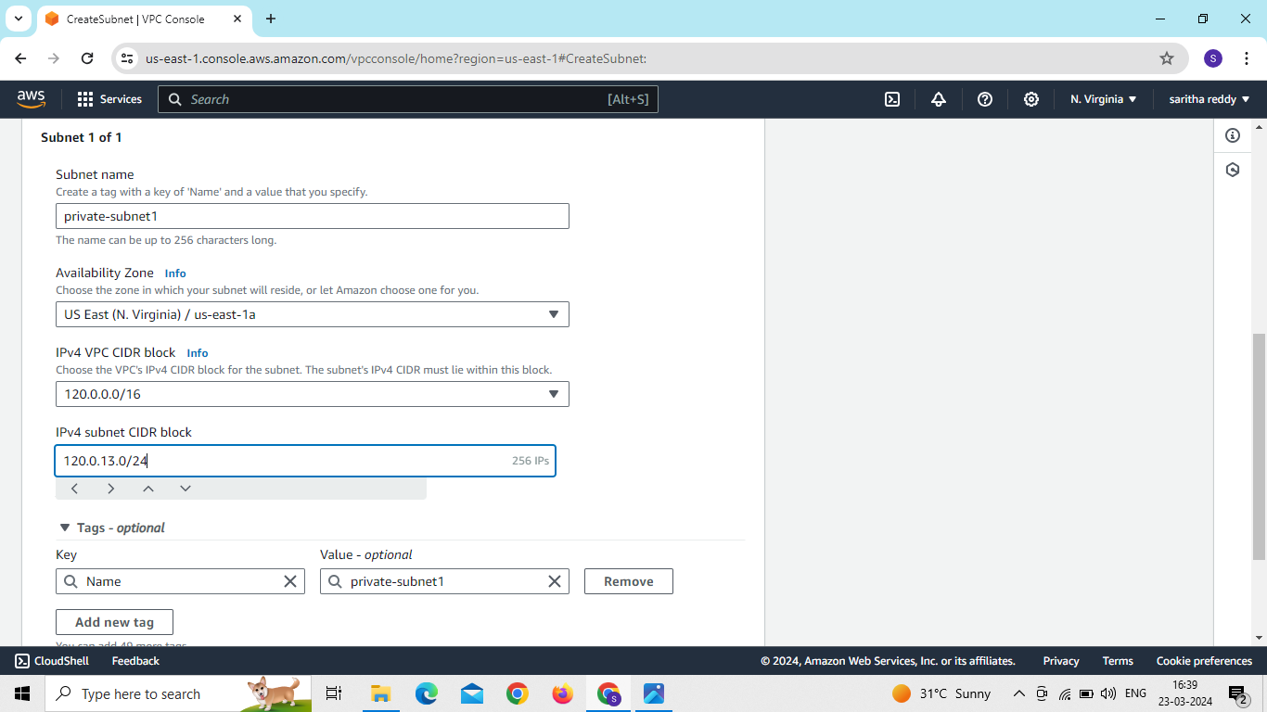
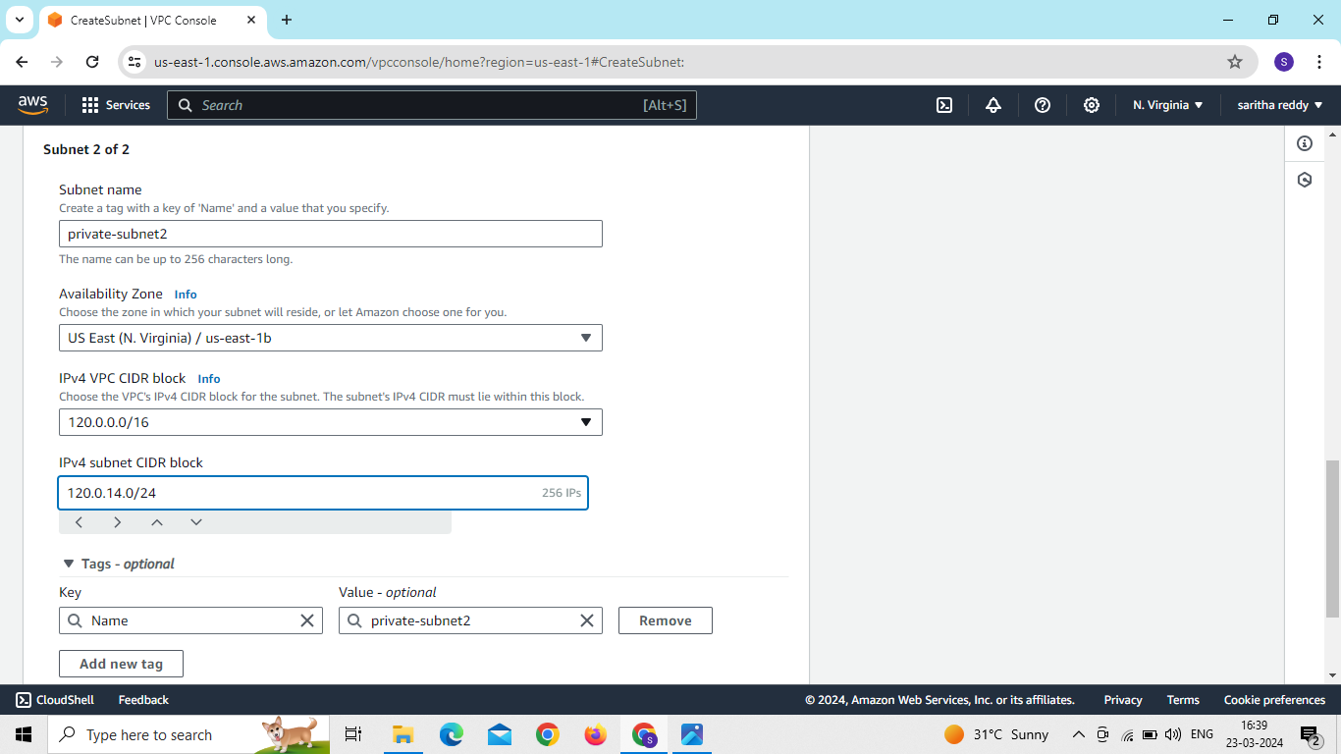

Slide 12
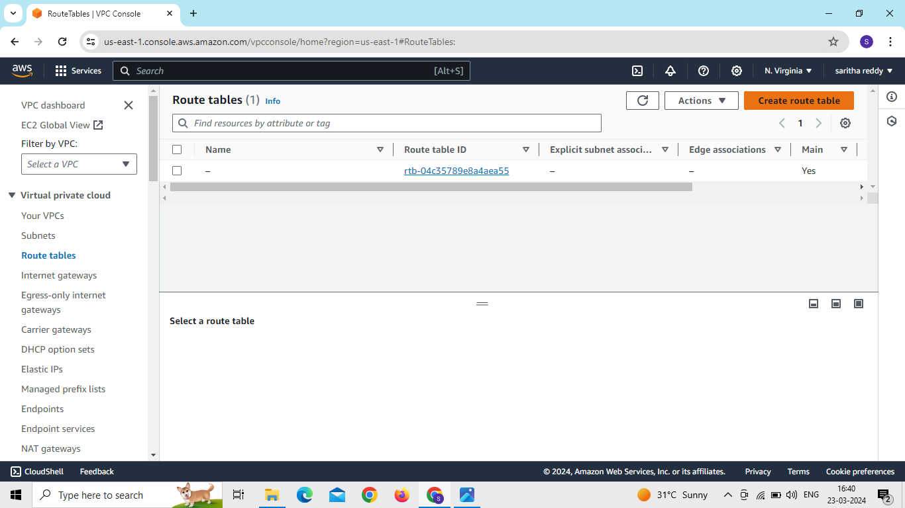
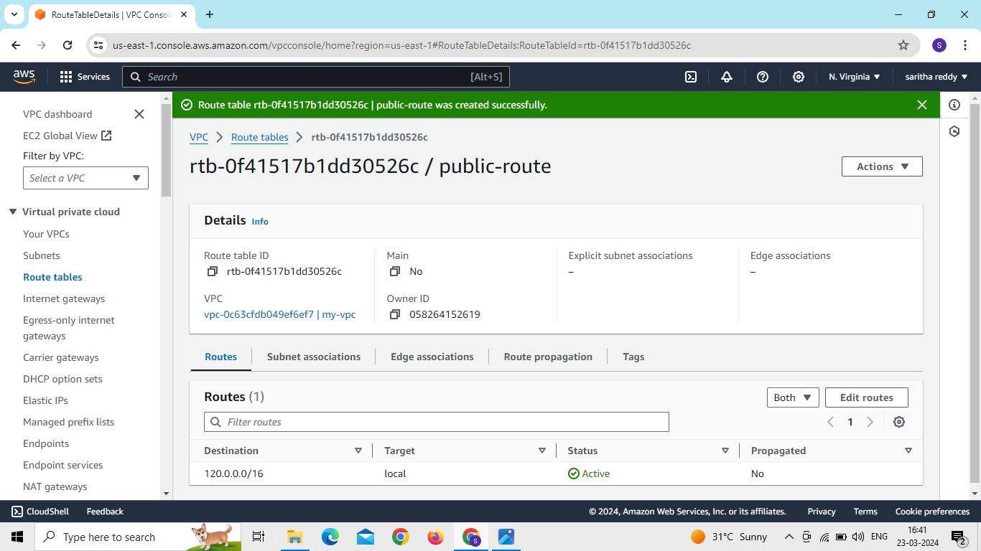
Go to route tables and create 2 route tables
Click on create route table

Slide 13
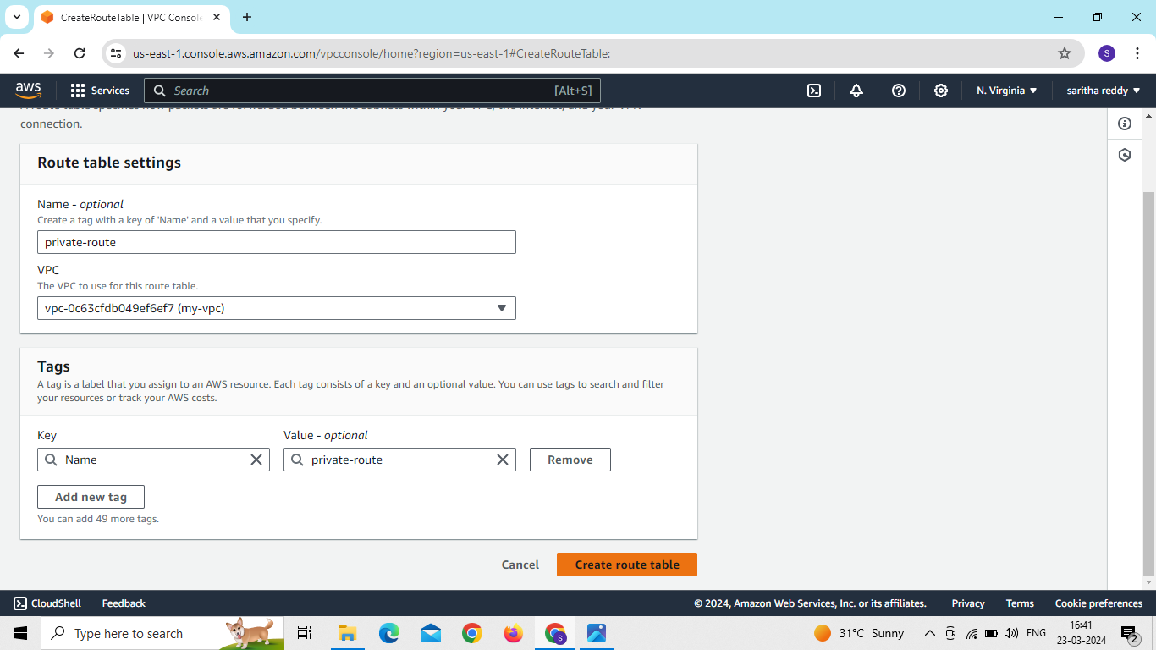
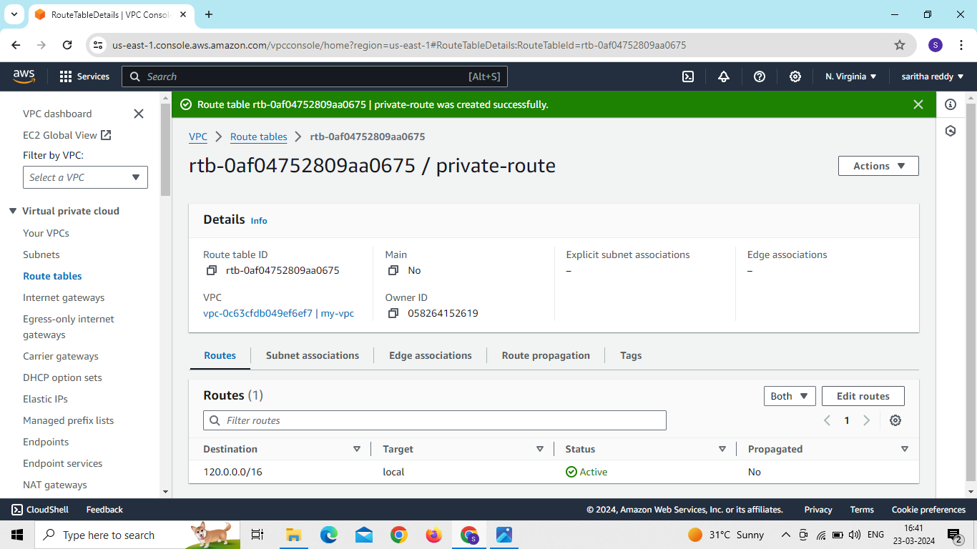

Slide 14
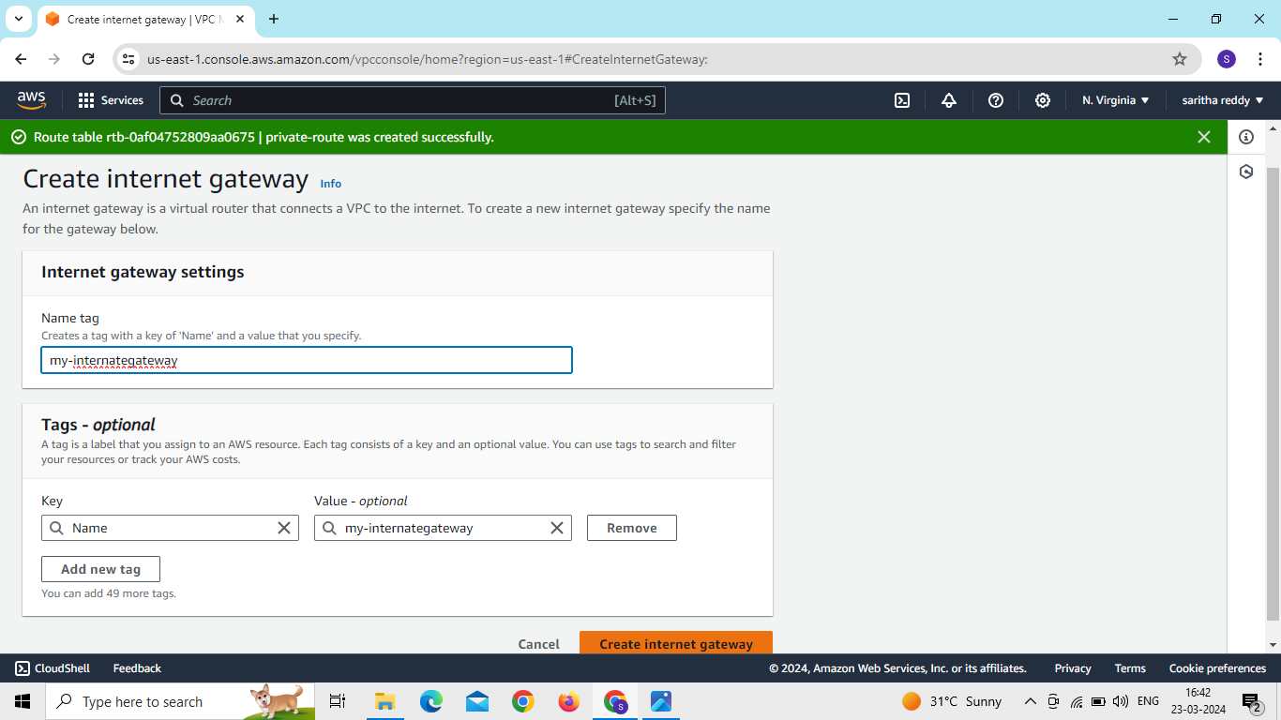
Create internate gate way and click on create internate gateway
Attached to our vpc

Slide 15
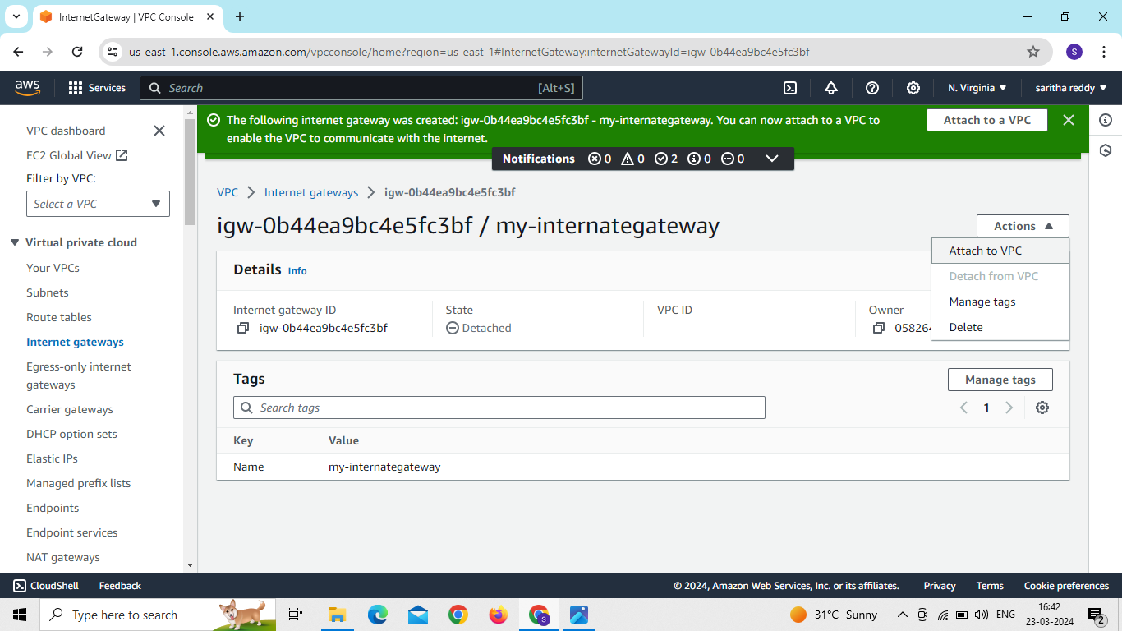
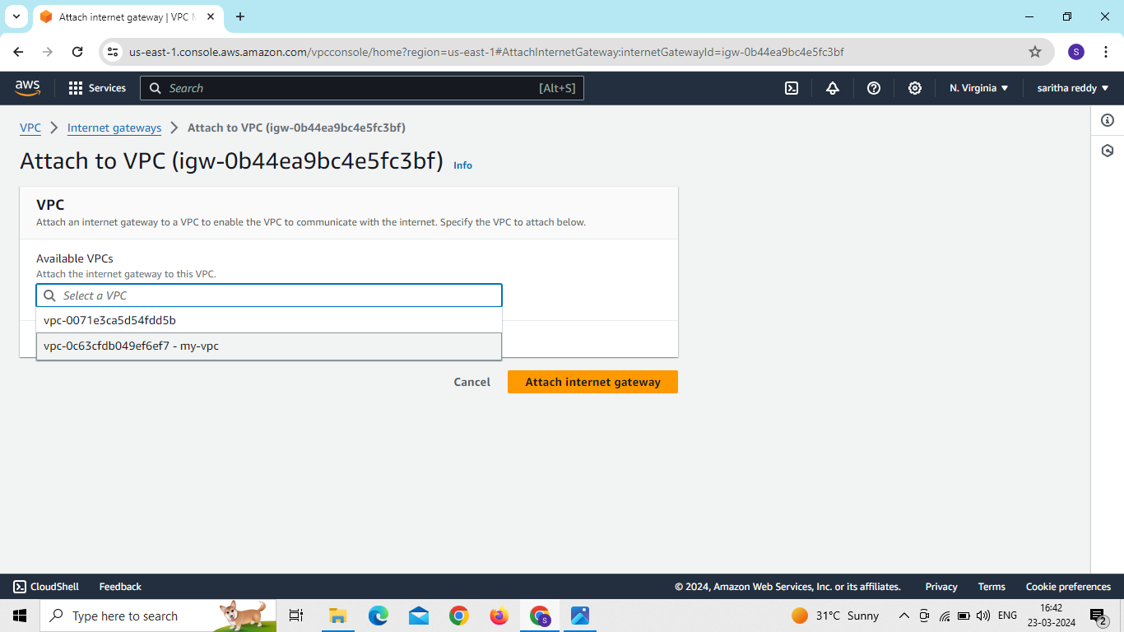

Slide 16
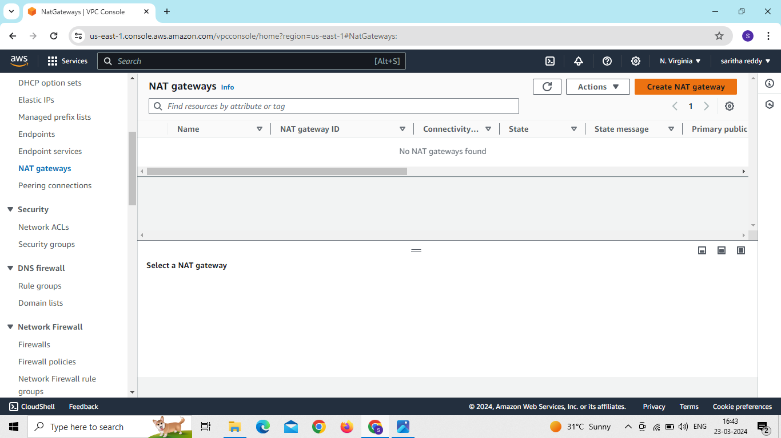
Create nat gateway and create name and select public subnet and allocate elastic ip and click on create nat gateway

Slide 17
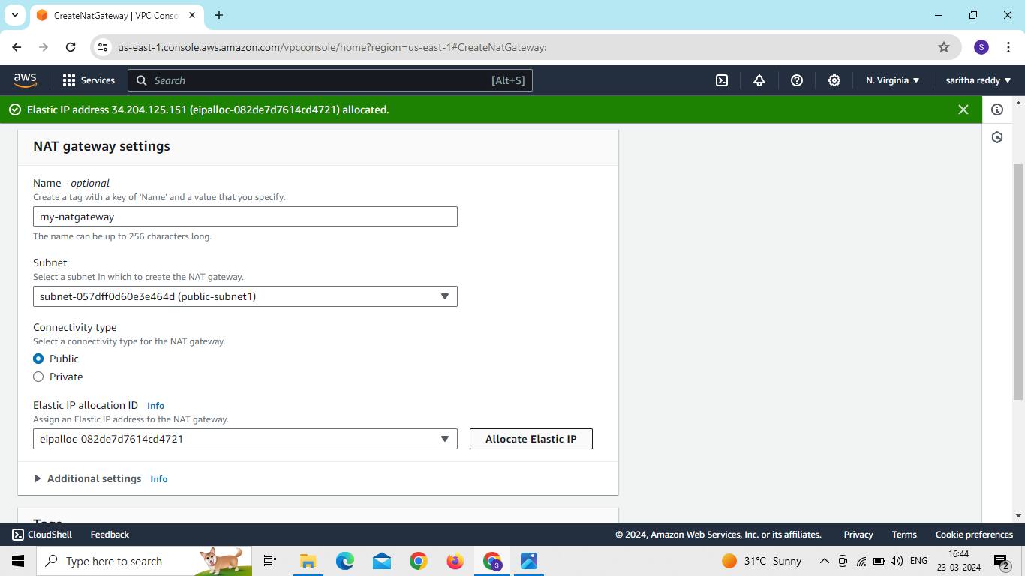

Slide 18
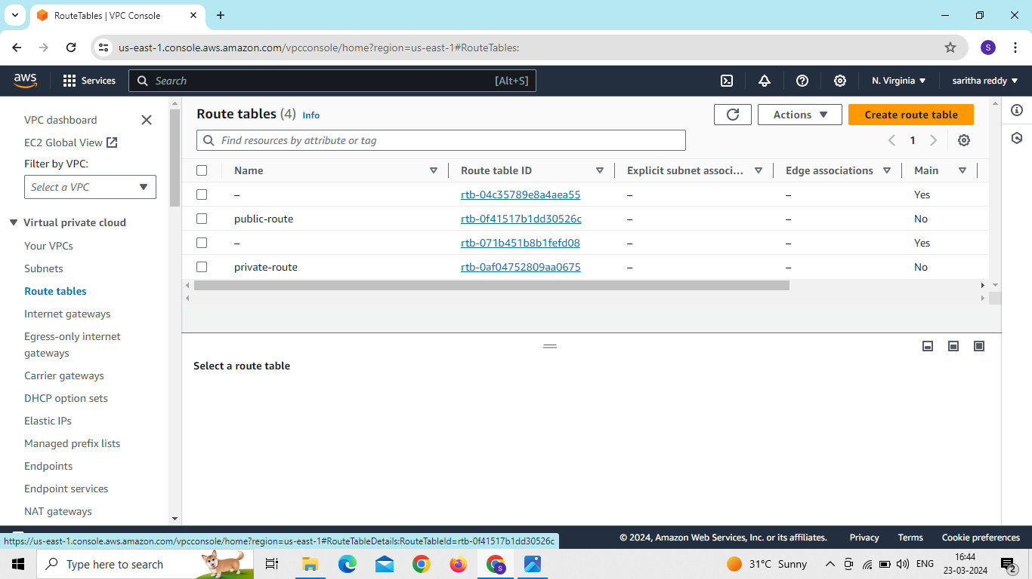
now go to route tables click on public route table id
go to actions and click on edit routes and add routes and give internet gateway connection and after click on save changes
go to subnet associations and click on edit subnet association and select our public subnets and click on save association

Slide 19
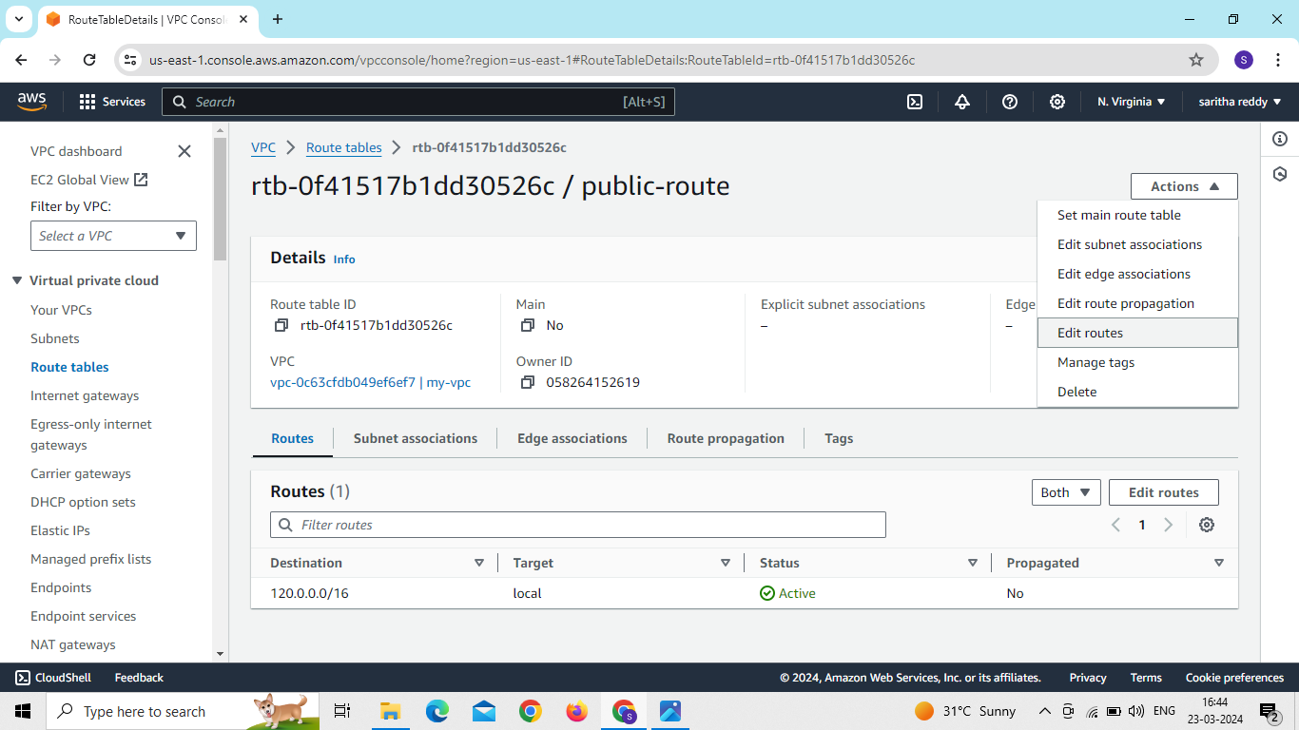
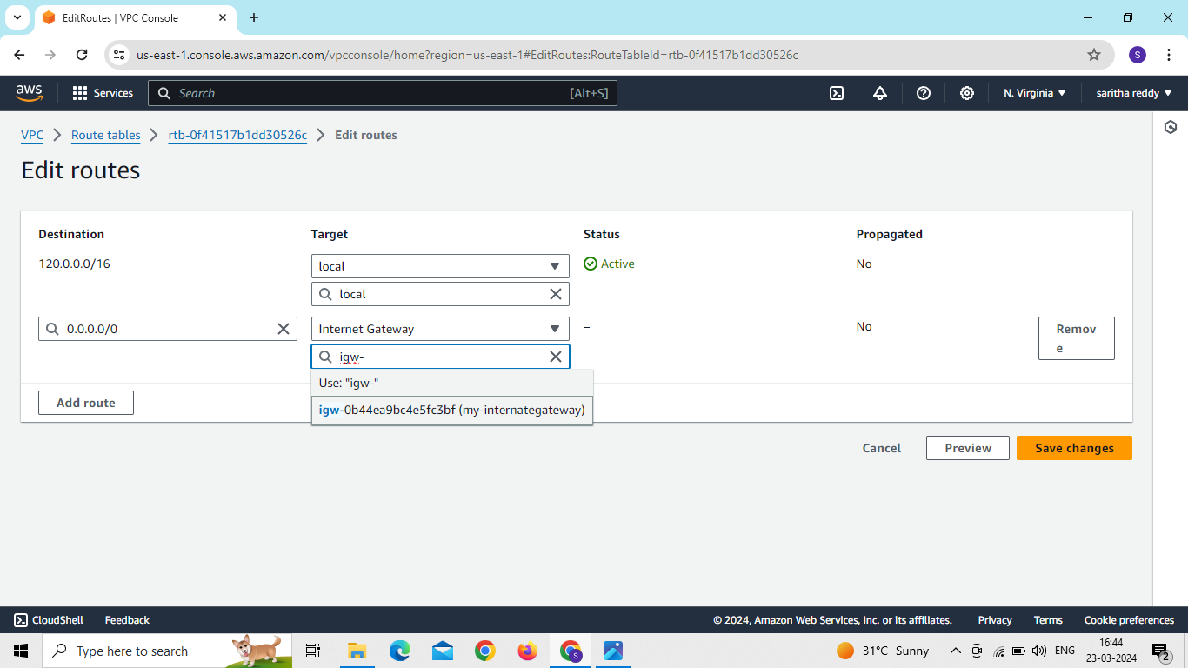

Slide 20
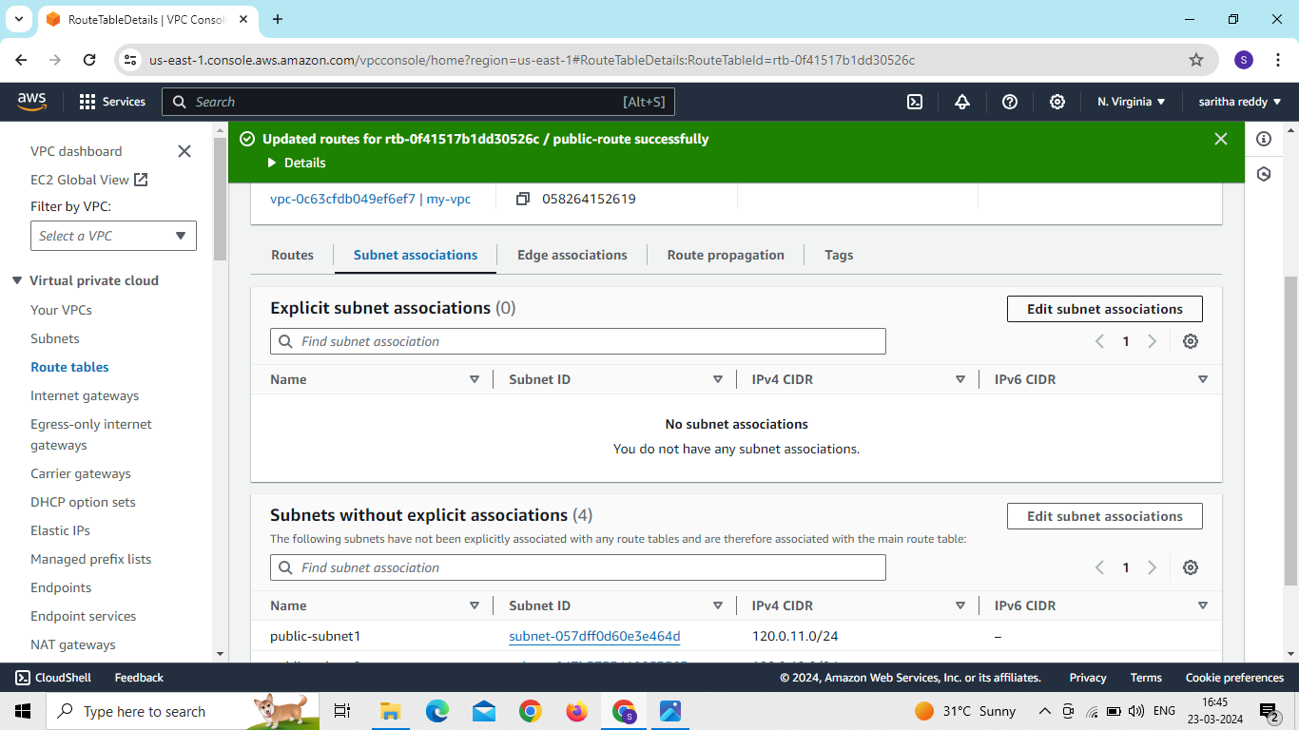
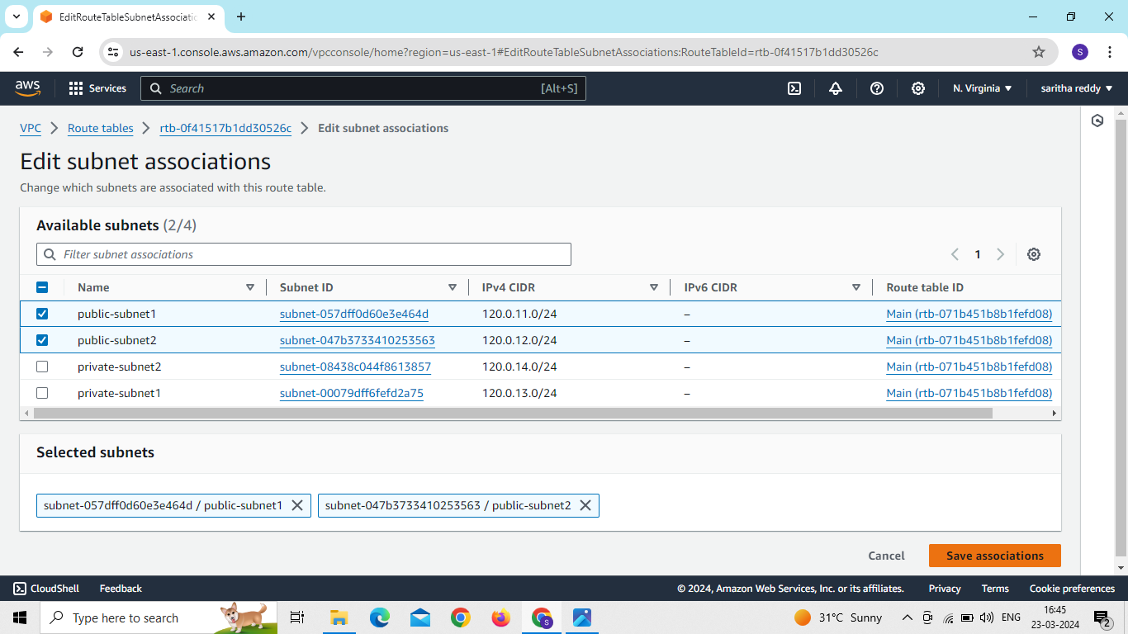

Slide 21

Now go to private route table and click on id
Go to actions and click on edit routes and add route and give nat gateway connection and click on save changes
Go to subnet associations click on edit subnet association and select private subnets and click on save association

Slide 22



Slide 23
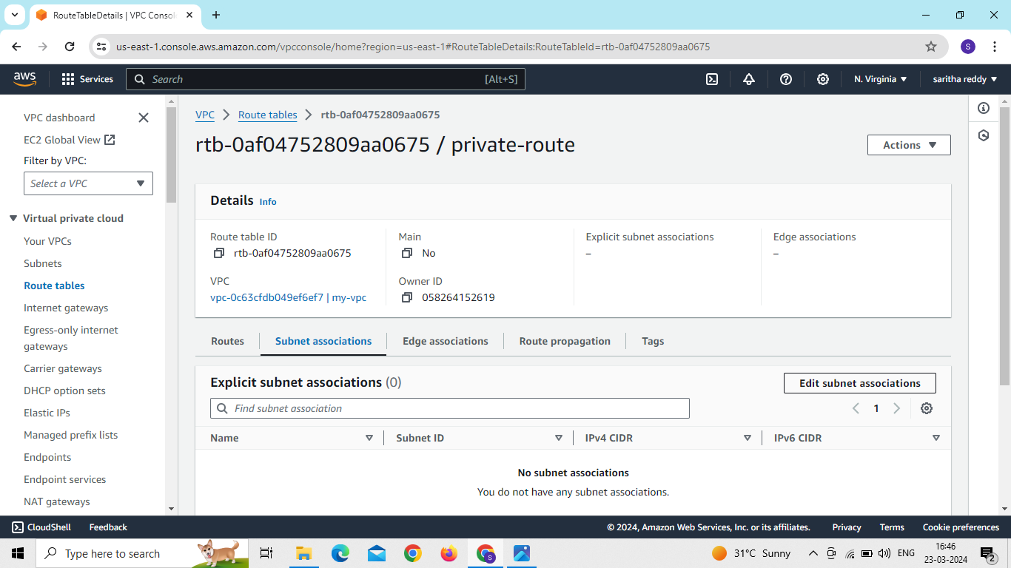
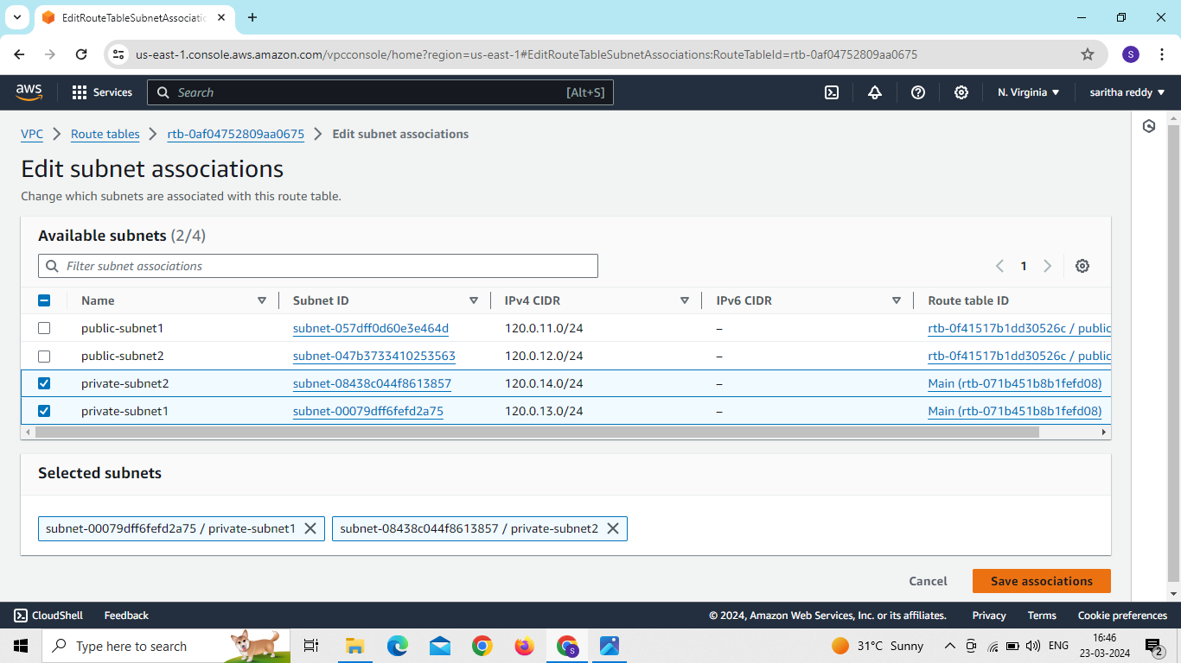

Slide 24
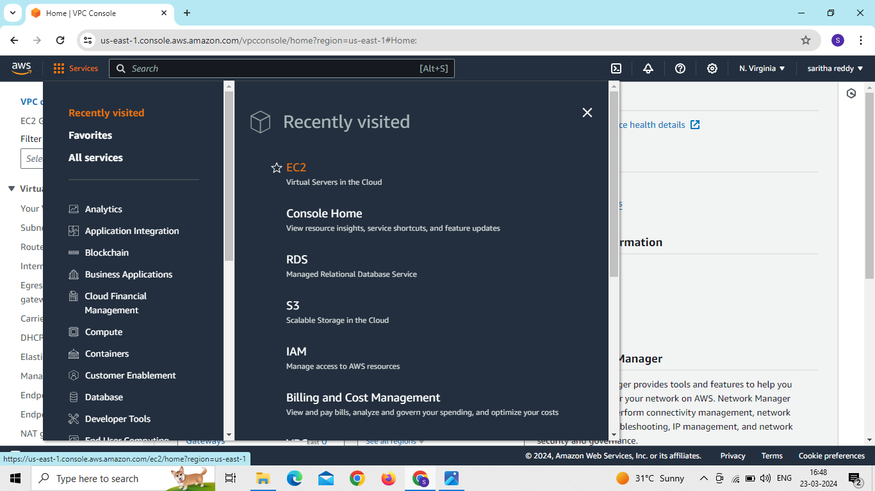
Now go to EC2 and create a instance

Slide 25
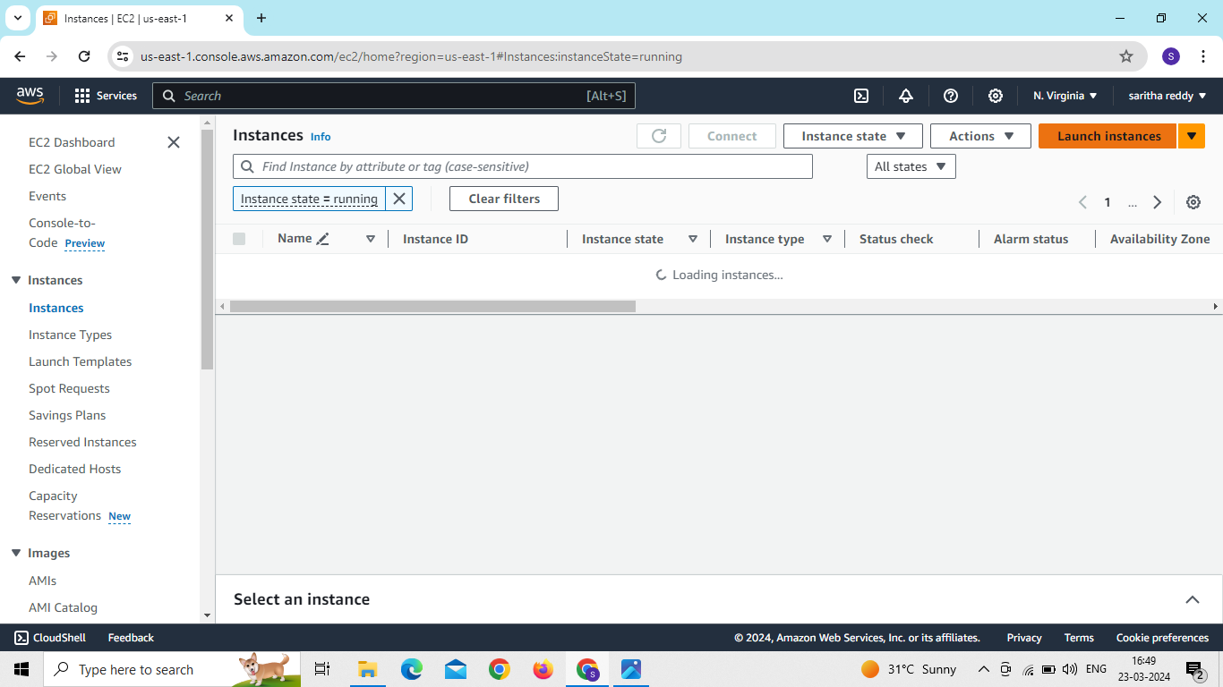
Click on launch instance,give instance name and select AMI machine image

Slide 26
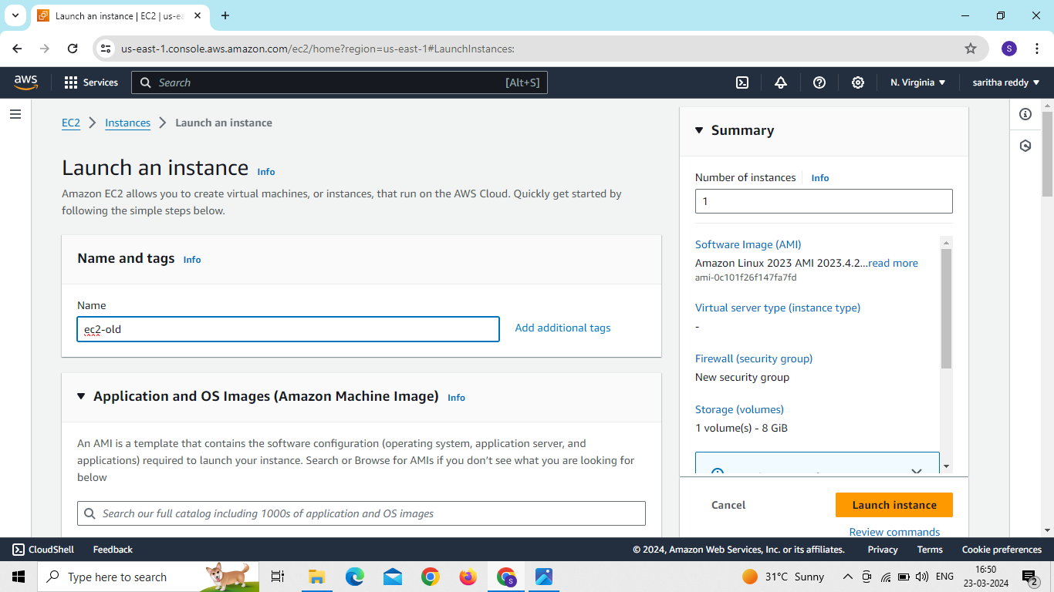
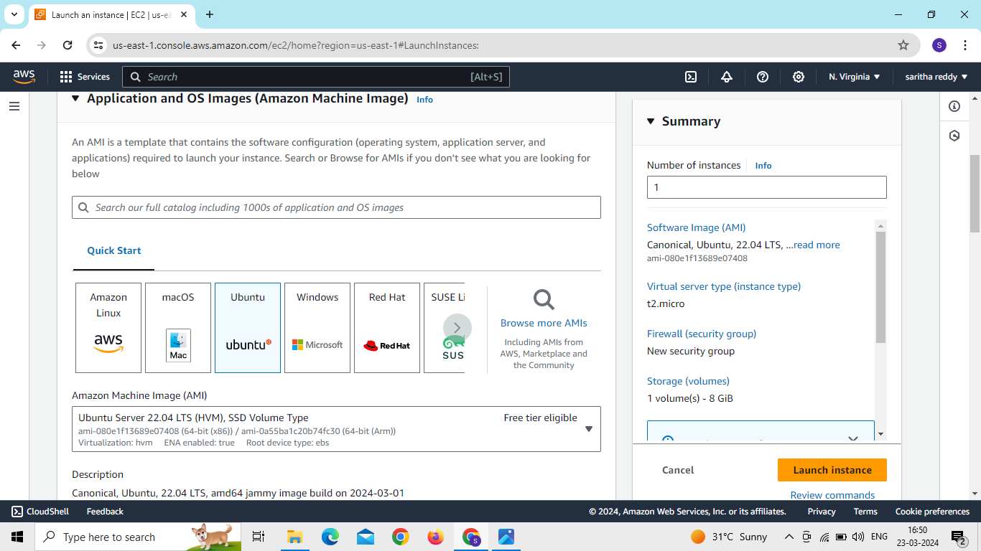

Slide 27
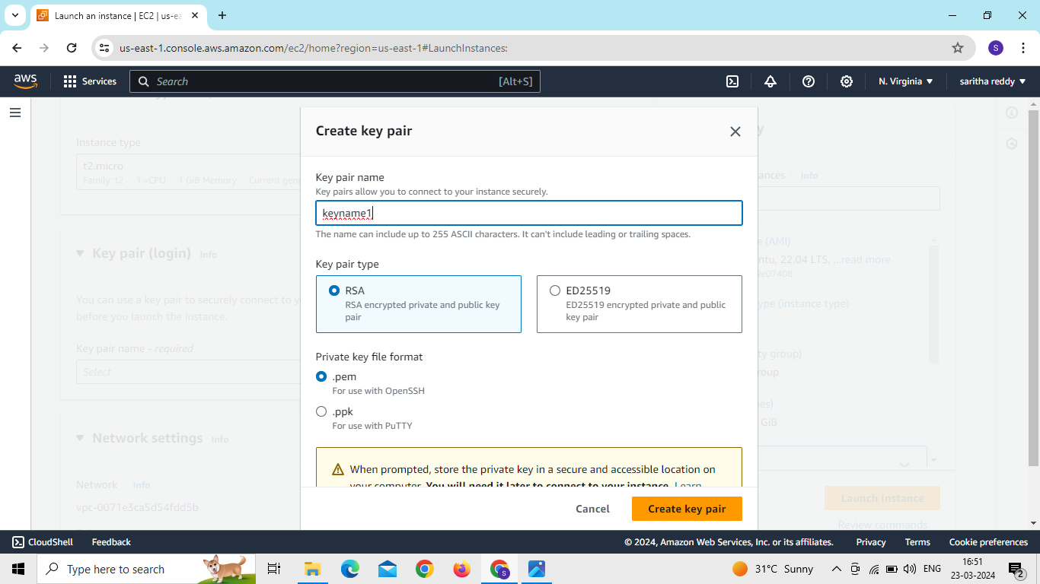
Select key pair name and click on create key pair

Slide 28
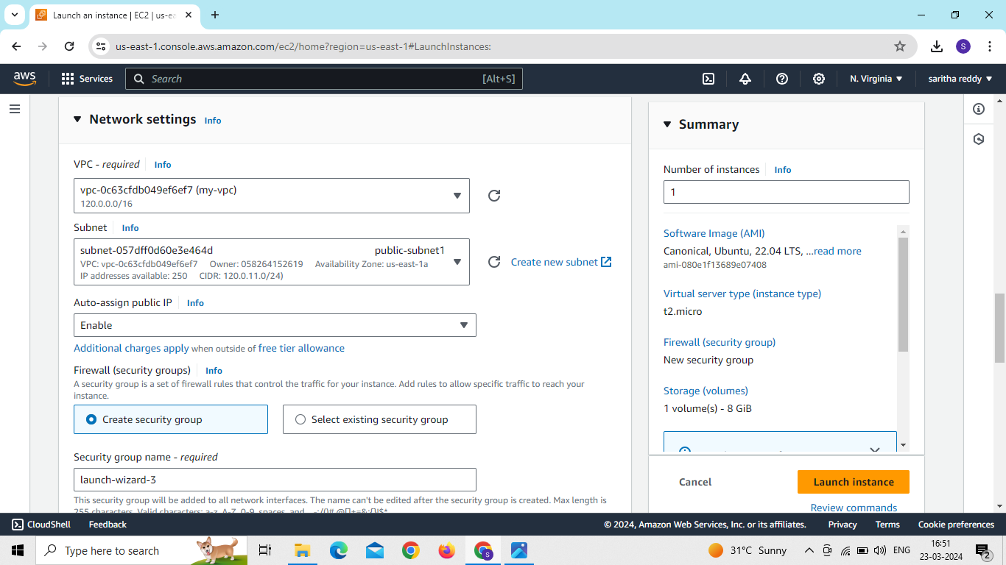
Now go to network setting and edit network setting
Select our vpc and public subnet
Enable public ip

Slide 29
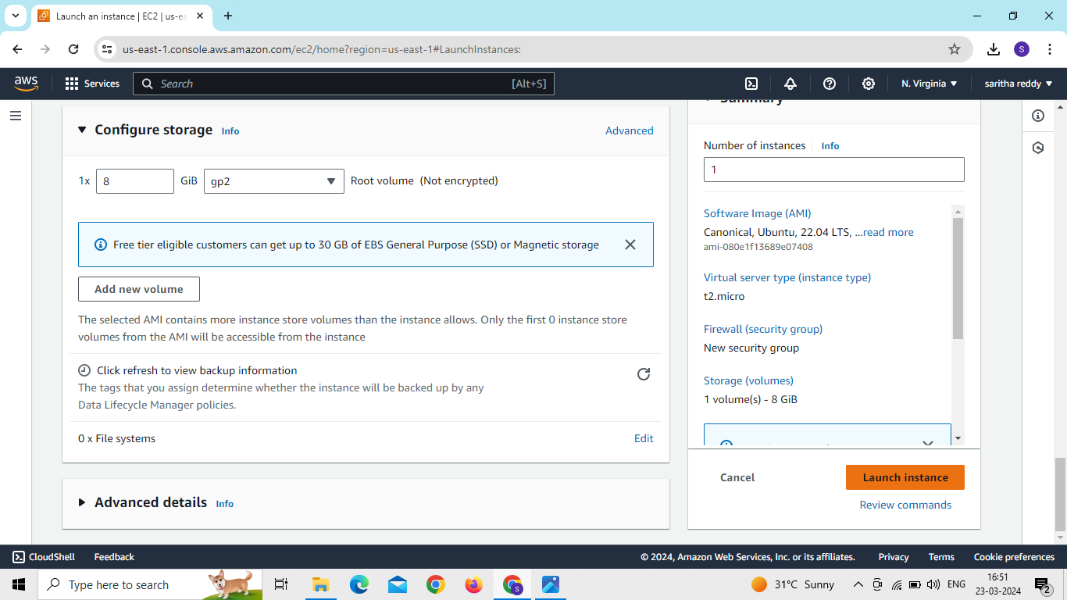
Click on launch instance

Slide 30
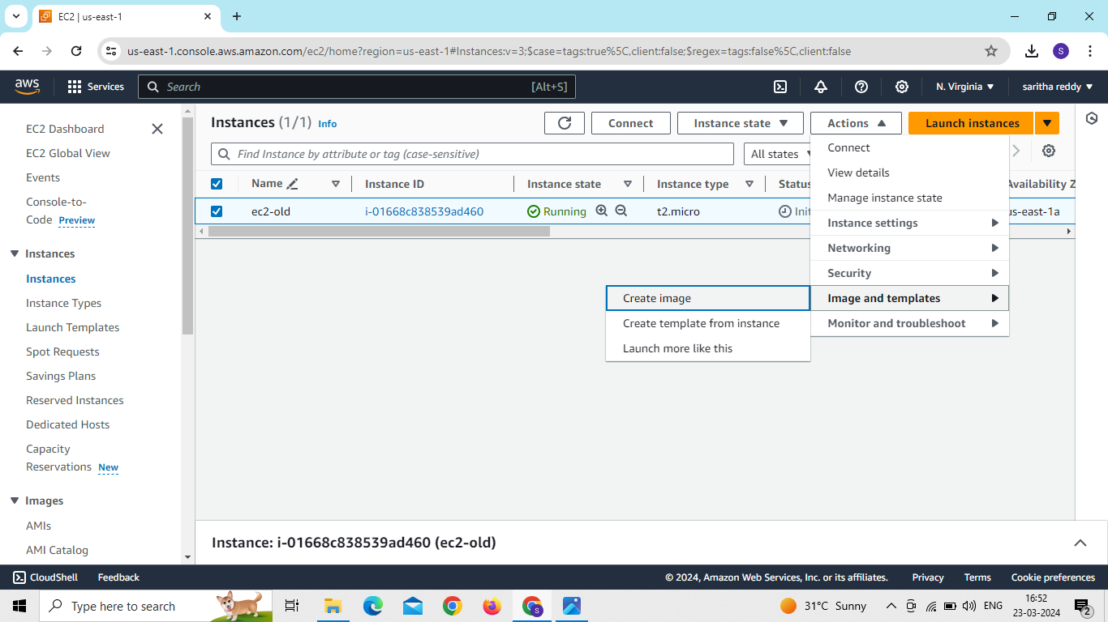
Click on check box , go to actions and select image and template and click on create image

Slide 31
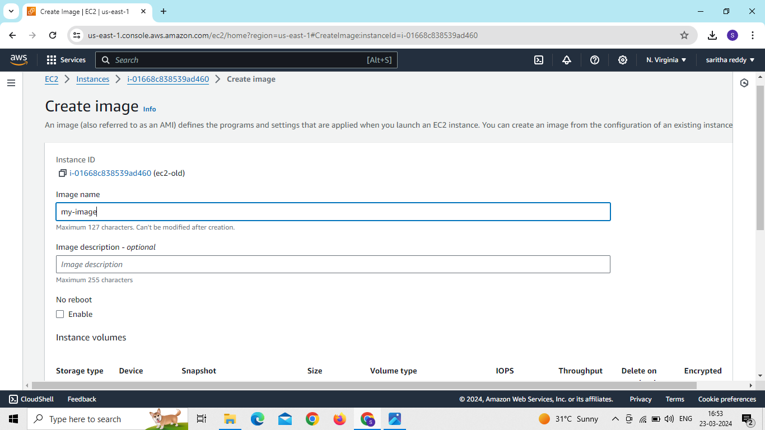
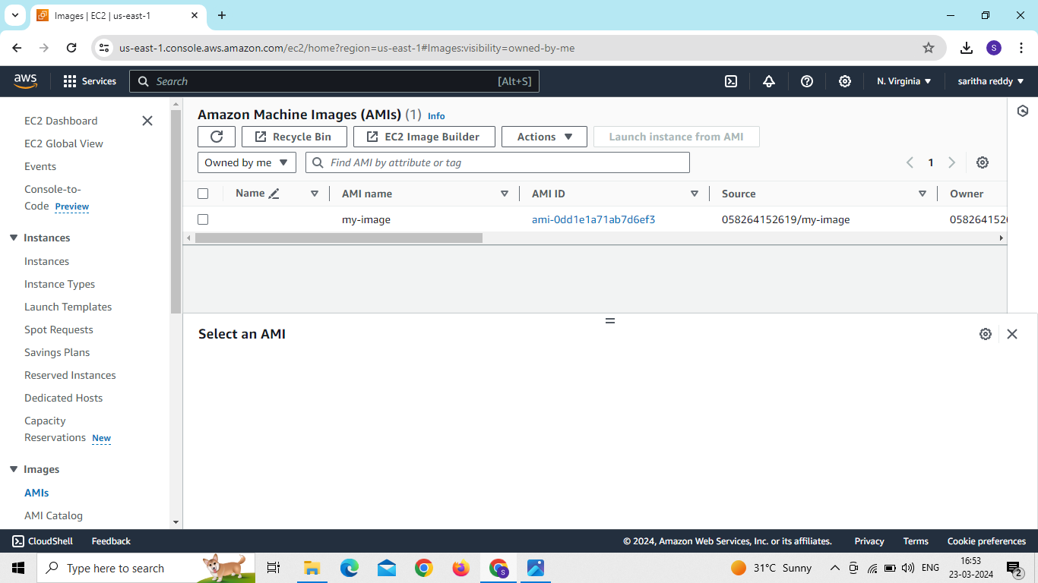

Slide 32
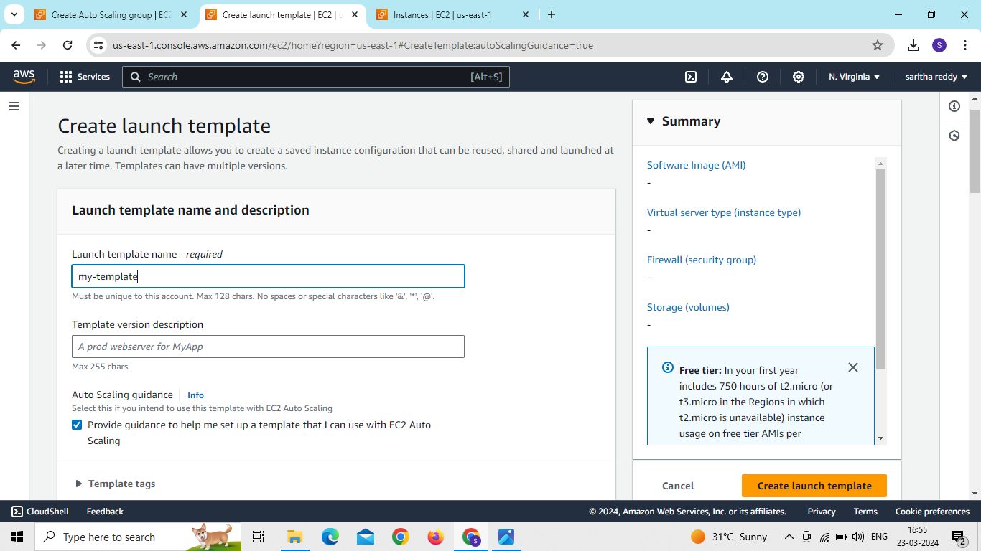
Go to launch templates and create launch template

Slide 33
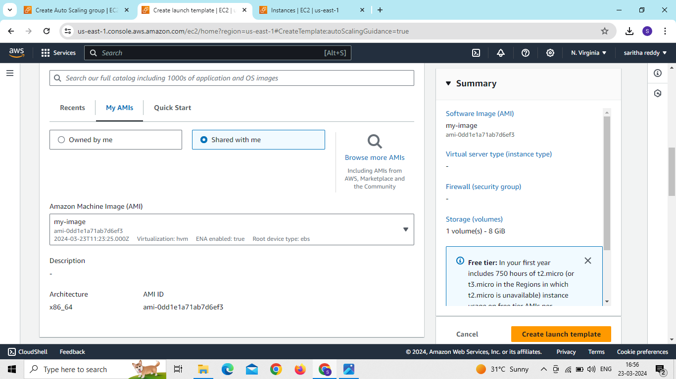
Select our My AMI image,key pair and instance type click on create launch template

Slide 34
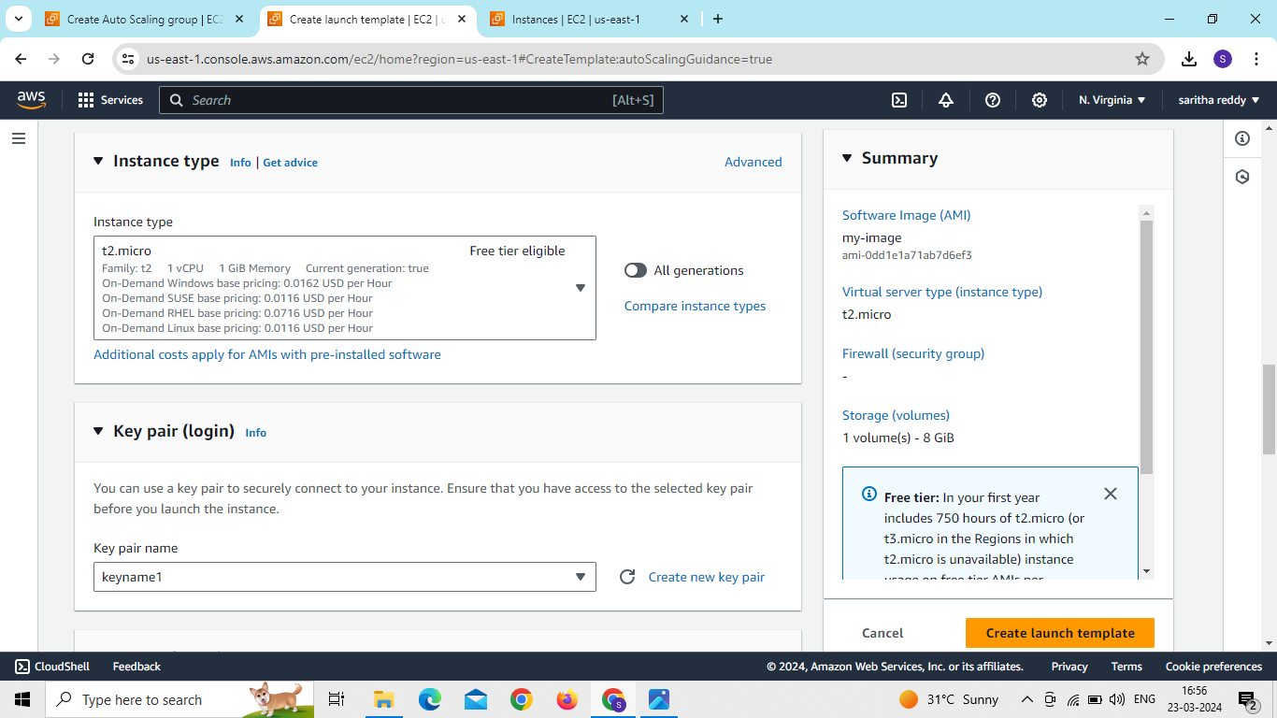
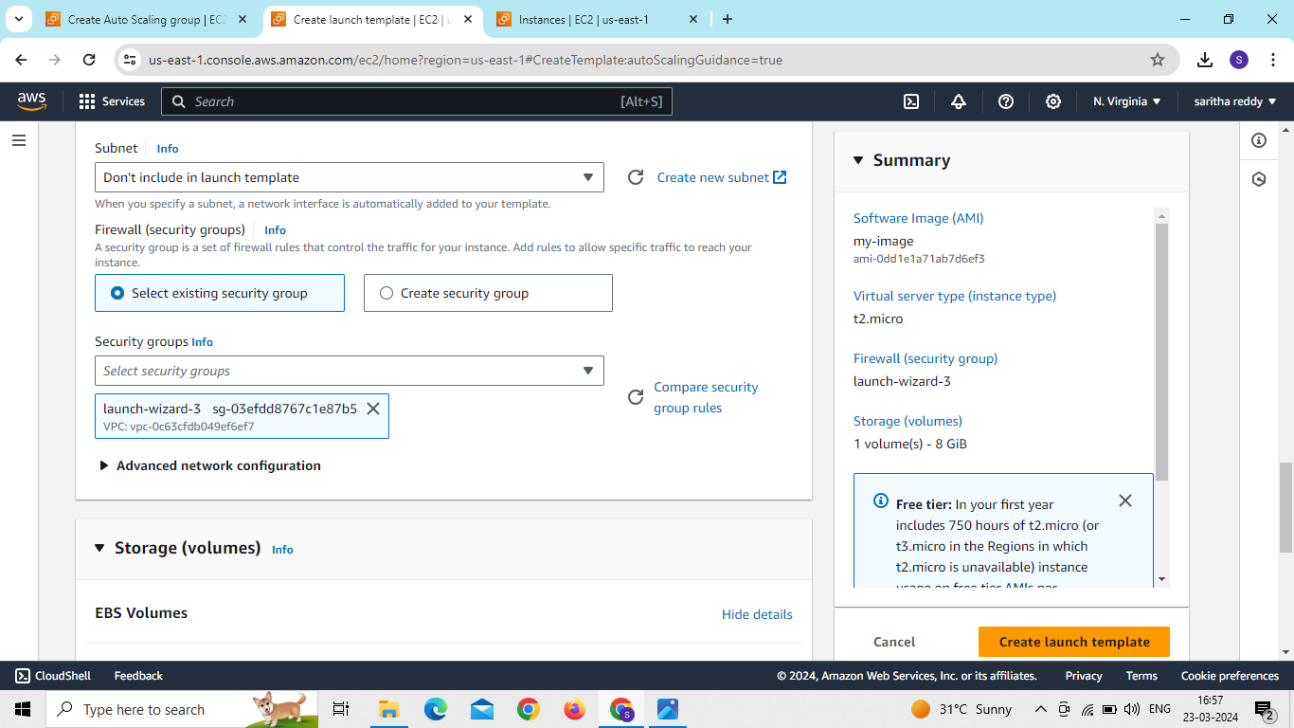

Slide 35
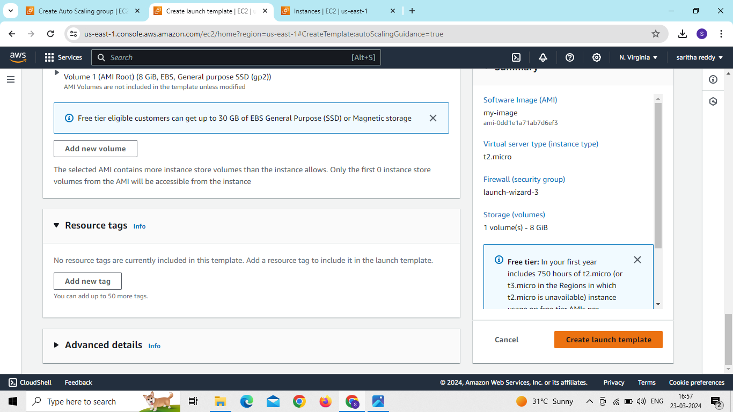
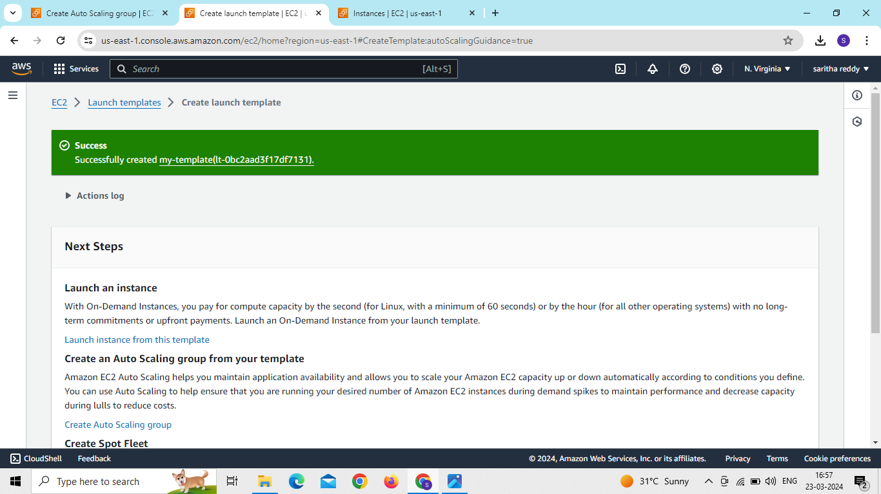

Slide 36
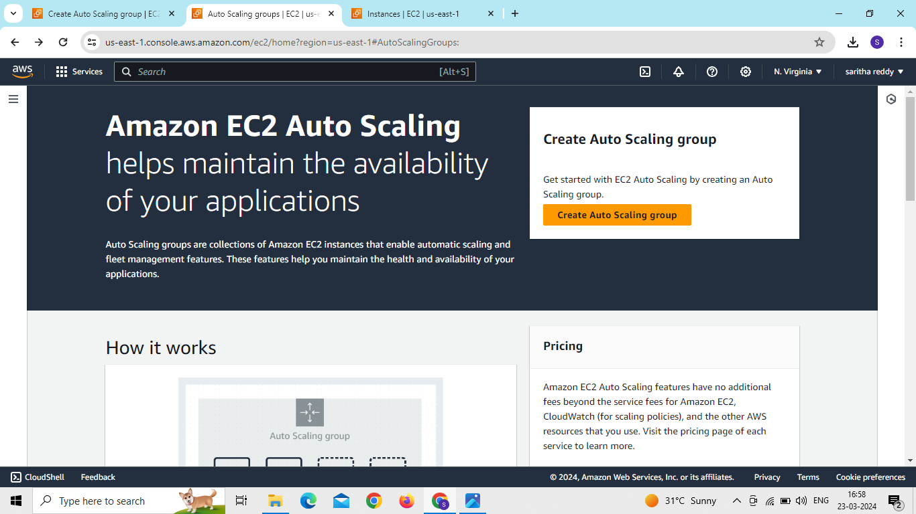
Go to autoscaling and create autoscaling
Select our vpc and public subnets
Select our launch template
Set time 50sec and then click on next

Slide 37
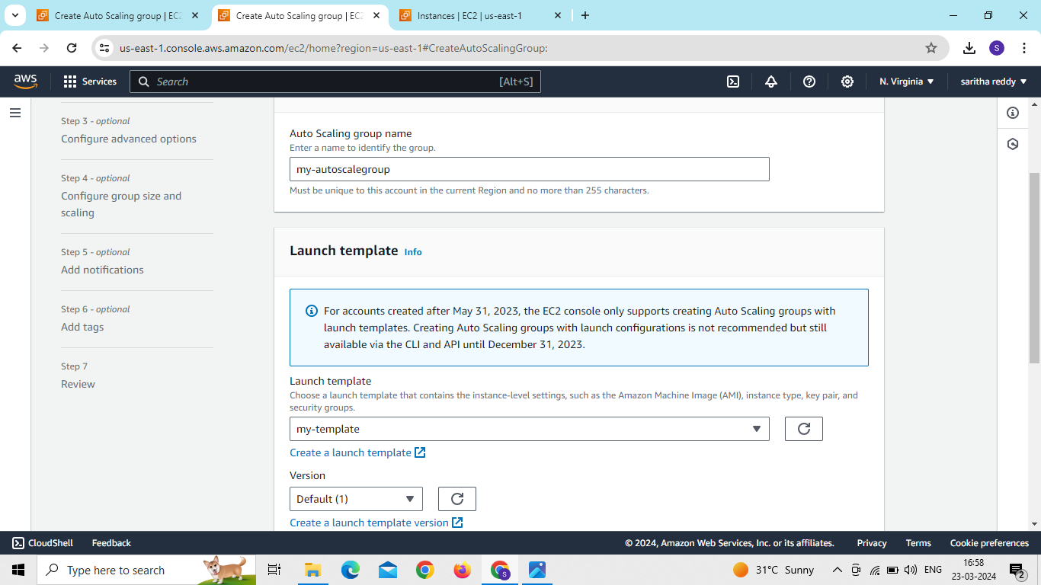
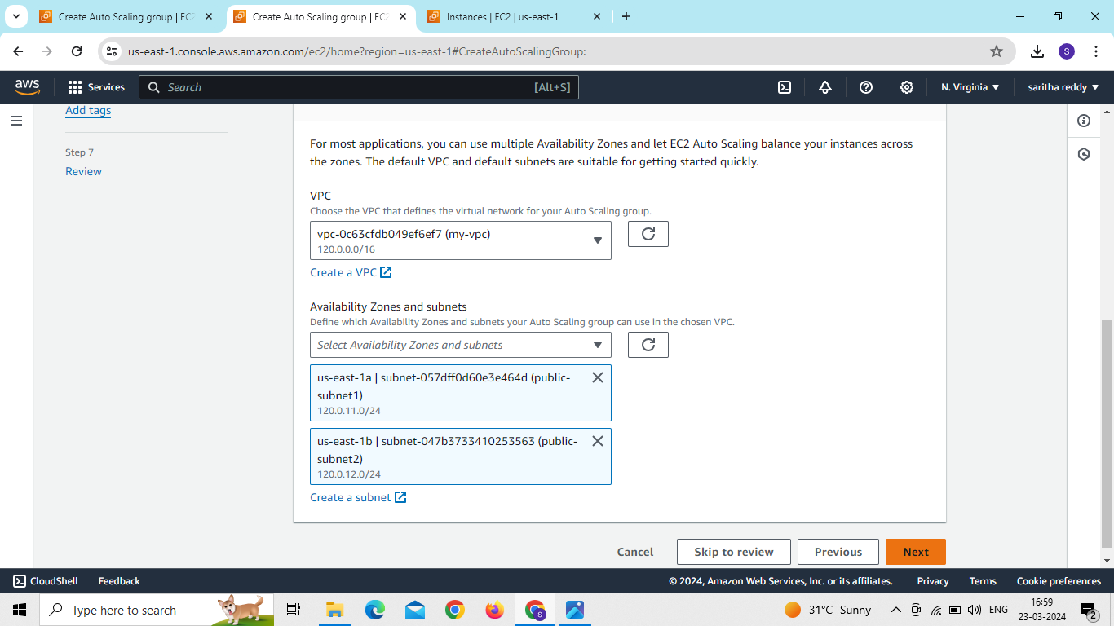

Slide 38
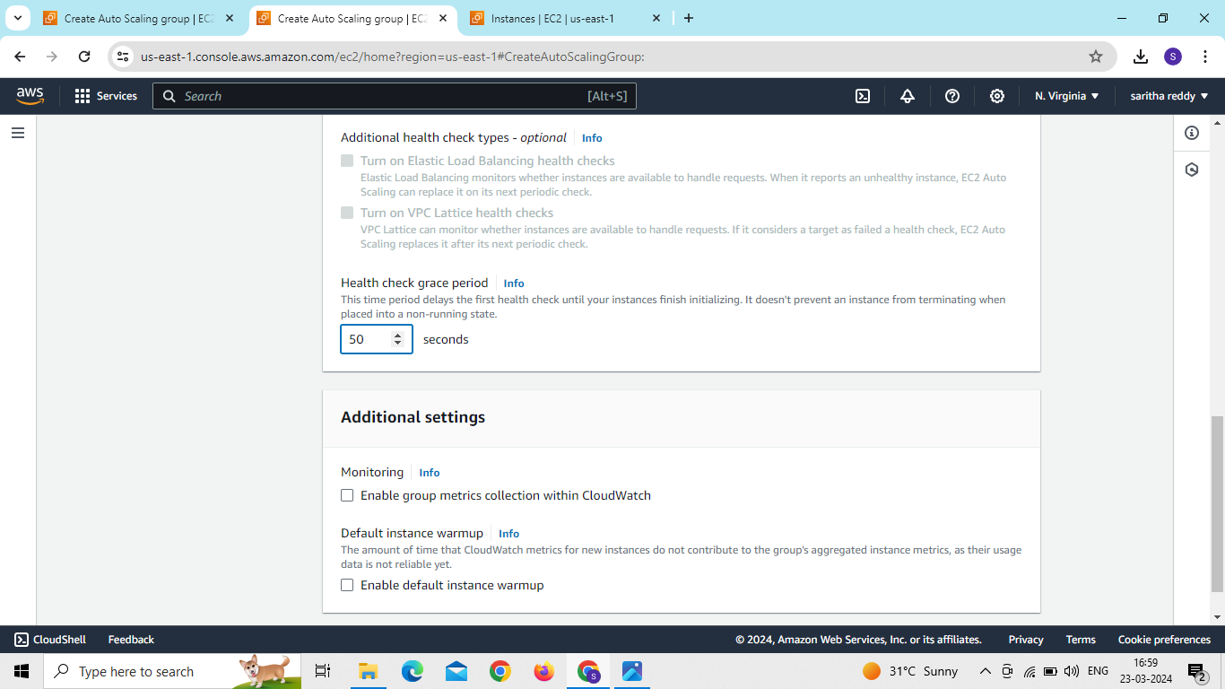


Slide 39


Slide 40

click on add notification
Create SNS topic

Slide 41


Slide 42


Slide 43

click on create autoscaling

Slide 44

Now create autoscale on private subnets
Set time 50 sec and then click on next
Select our launch template

Slide 45



Slide 46



Slide 47



Slide 48


Slide 49

After autoscaling group we can see the servers automatically created

Slide 50

Create 2 private subnets for RDS

Slide 51



Slide 52
Now go to RDS

Slide 53

Now go to db-subnet group
Create db-subnet name

Slide 54

Give subnet group name
Description – allow
Select our vpc
Select subnets of our availability zones

Slide 55


Slide 56


Now go to rds and create database
Select engine type “My-sql”

Slide 57



Slide 58



Slide 59

Click on create database

Slide 60


now go to ec2 and connect to the server

Slide 61
We use commands
Sudo apt update
Sudo apt install mysql-server
Sudo systemctl start mysql-server
Mysql –h <end point> -u admin -p

Slide 62



Slide 63

Now go to rds and give ec2-setup

Slide 64

select our ec2 instance id

Slide 65


Slide 66


Slide 67

copy the rds end point
Mysql –h <endpoint> -u admin -p

Slide 68

Now we can see the database connected to the My-sql server

